Slide 1
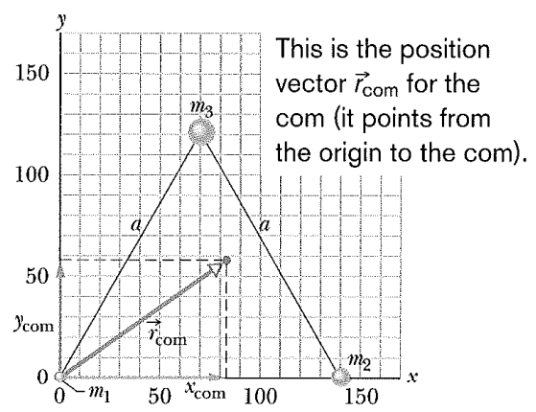
Three particles of masses m₁ = 1.2 kg, m₂ = 2.5 kg, and m₃ = 3.4 kg form an equilateral triangle of edge length a = 140 cm. Where is the center of mass of this system?

Slide 2
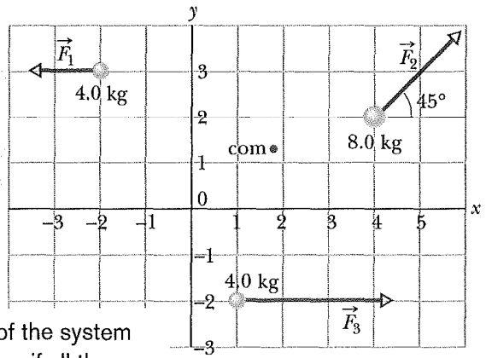
The three particles in the figure are initially at rest. Each experiences an external force due to bodies outside the three-particle system. The directions are indicated, and the magnitudes are F₁=6.0 N, F₂= 12 N, and F₃=14 N. What is the acceleration of the center of mass of the system, and in what direction does it move?

Slide 3
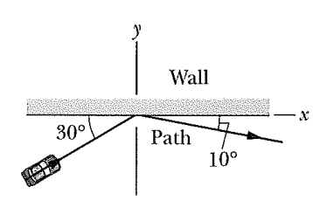
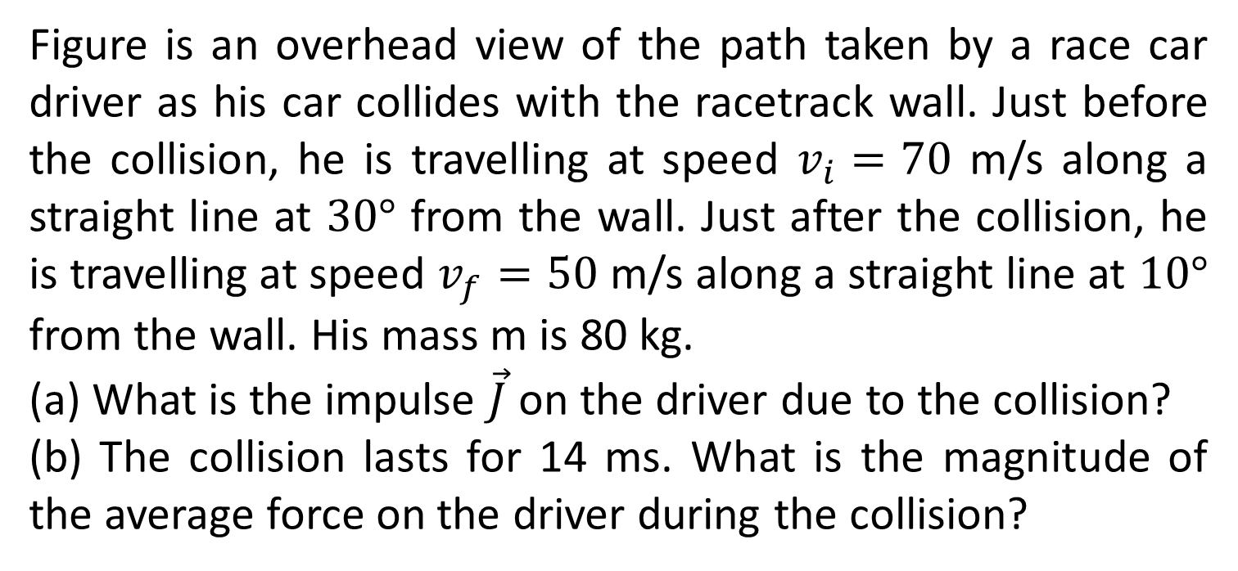
Figure is an overhead view of the path taken by a race car driver as his car collides with the racetrack wall. Just before the collision, he is travelling at speed $v_{i}=70$ m/s along a straight line at $30°$ from the wall. Just after the collision, he is travelling at speed $v_{f}=50$ m/s along a straight line at $10°$ from the wall. His mass m is 80 kg.
(a) What is the impulse $\vec{J}$ on the driver due to the collision?
(b) The collision lasts for 14 ms. What is the magnitude of the average force on the driver during the collision?

Slide 4
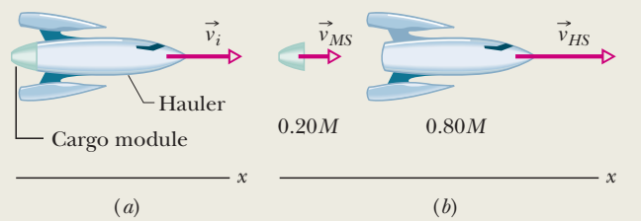
As in the figure shows a space hauler and cargo module, of total mass M, traveling along an x axis in deep space. They have an initial velocity of magnitude 2100 km/h relative to the Sun. With a small explosion, the hauler ejects the cargo module, of mass 0.20M (Fig. b). The hauler then travels 500 km/h faster than the module along the x-axis; that is, the relative speed v_{rel} between the hauler and the module is 500 km/h. What then is the velocity v_{HS} of the hauler relative to the Sun?

Slide 5
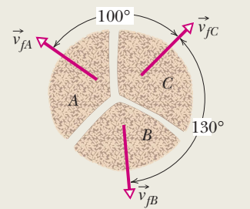
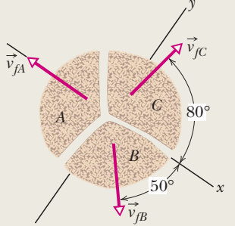
A firecracker placed inside a coconut of mass M, initially at rest on a frictionless floor, blows the coconut into three pieces that slide across the floor. An overhead view is shown in Fig. Piece C, with mass 0.30M, has final speed v_{fC}=5.0 m/s.
What is the speed of piece B, with mass 0.20M?
What is the speed of the part A?

Slide 6
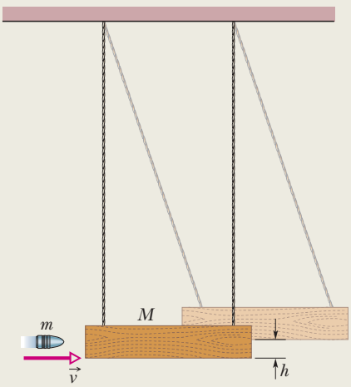
The ballistic pendulum was used to measure the speeds of bullets before electronic timing devices were developed. The version shown in Fig. consists of a large block of wood of mass M = 5.4 kg, hanging from two long cords. A bullet of mass m = 9.5 g is fired into the block, coming quickly to rest. The block bullet then swing upward, their center of mass rising a vertical distance h =6.3 cm before the pendulum comes momentarily to rest at the end of its arc. What is the speed of the bullet just prior to the collision?

Slide 7
